Slide 1
DIGITAL BOARD MARKER (Final Year Project)
Advisor:
Mr. Samyan Qayyum Wahla
Group Members:
Muhammad Haris Khan [2016-CS-105]
Hamza Farooq [2016-CS-122]
Ayesha Atif [2016-CS-152]
Komal Shehzadi [2016-CS-178]

Slide 2


AGENDA
01
Introduction
Demo Video
Objectives
Scope
Applications
02
Comparison
03
Feasibility Study
04
Problem Statement
05
Proposed System
06
Requirements
07
Project Modules
08
Annual Plan
09
Process Methodology
10
Business Plan
11
References

Slide 3
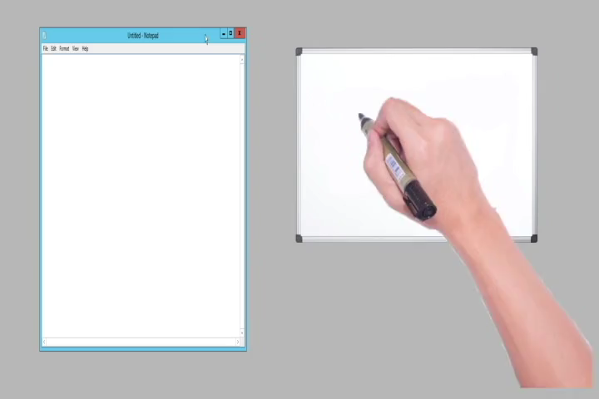
Demo Video

Slide 4


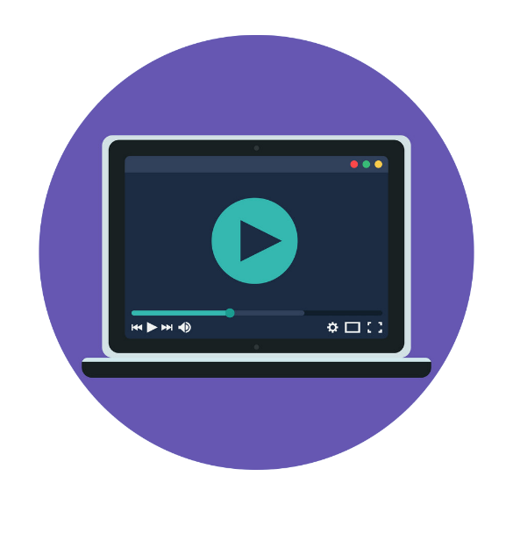

PROJECT OVERVIEW
Storage Efficient System
Complete LMS
Bandwidth Efficient System
Offline Player

Slide 5

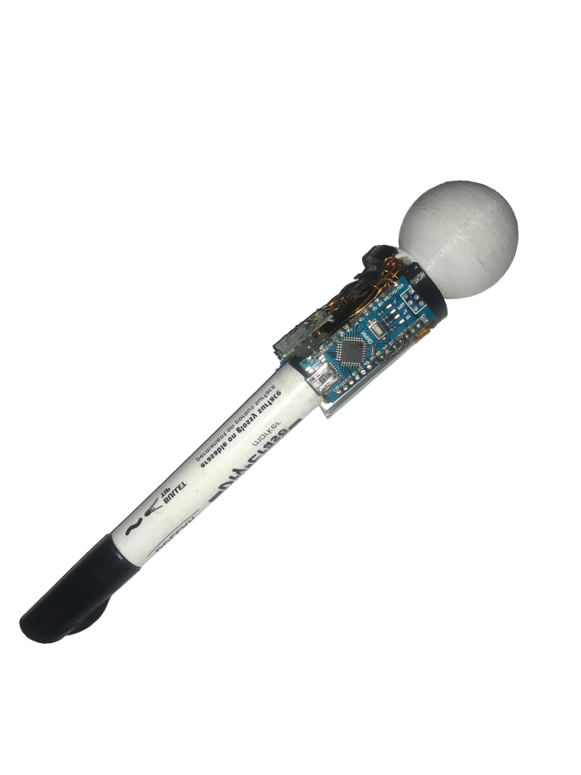




MOTIVATION
Minimizing Resources
Difficulty in writing Notes as well as listening and understanding
Less bandwidth usage
Less storage
Play without internet

Slide 6
INDUSTRY OBJECTIVES
Availability of resources at industrial sites with low internet bandwidth.
No need to pay high internet bills for remote places.
Sudden meetings and plans can be shared with anyone at any time.

Slide 7
RESEARCH OBJECTIVES
Accurate position detection using computer vision.
Automatic notes generation.
Automatic google searching .
Handwriting recognition.

Slide 8
ACADEMIC OBJECTIVES
Utilization of less internet resources
Accessibility of all the available lectures on a single platform.
Active learning of students.
Complete focus on lecture.

Slide 9
SCOPE
The proposed system will:
Record lecture with two stereo vision cameras frame rate 60 FPS.
Animate lecture on web application and also on the offline player.
Serve as an innovative LMS.
Record lecture using two camera stereo vision.
Record voice and board marker position data using custom developed wireless modules.
Use a whiteboard of dimension 4x3 ft.
Play lectures on a dedicated player (json to video player).
Store json data in encrypted format which will be later used in formation of video animation

Slide 10




APPLICATION AREAS
Educational Institutes
DBM
Applications
Industrial Presentations
Sketch Artists
Online Tutors

Slide 11
AGENDA
01
Introduction
Demo Video
Objectives
Scope
Applications
02
Comparison
Comparison with existing systems
03
Feasibility Study
04
Problem Statement
05
Proposed System
06
Requirements
07
Project Modules
08
Annual Plan
09
Process Methodology
10
Business Plan
11
References

Slide 12
COMPARISON WITH EXISTING SYSTEMS
Initiative | Storage Efficiency | Encrypted format | Dedicated Player | Custom Content | Brandable | Free to Access | For Profit | Class Strength
Edx | ✕ | ✕ | ✕ | ✓ | ✓ | ✓ | ✕ | 300,000
Moodle | ✕ | ✕ | ✕ | ✕ | ✓ | ✓ | ✓ | 10,000
Coursera | ✕ | ✕ | ✕ | ✓ | ✕ | ✓ | ✓ | Unlimited
Udemy | ✕ | ✕ | ✕ | ✓ | ✕ | ✕ | ✓ | Unlimited
Udacity | ✕ | ✕ | ✕ | ✓ | ✓ | ✓ | ✓ | Unlimited
DBM | ✓ | ✓ | ✓ | ✓ | ✓ | ✓ | ✓ | Unlimited

Slide 13
AGENDA
01
Introduction
02
Comparison
Comparison with existing systems
03
Feasibility Study
Technical Feasibility
Operational Feasibility
Economical Feasibility
04
Problem Statement
05
Proposed System
06
Requirements
07
Project Modules
08
Annual Plan
09
Process Methodology
10
Business Plan
11
References

Slide 14
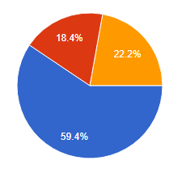
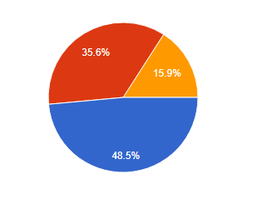
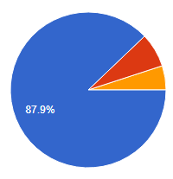
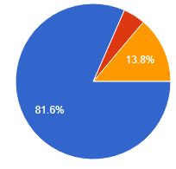
Technical Feasibility
6.4%
6%
6.1%
Students having trouble to note down lecture
Students with less storage issue
Students who want to access their class lectures at any time.
Students who want this system implemented in their institutes
Yes
No
Maybe

Slide 15
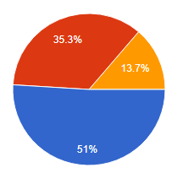
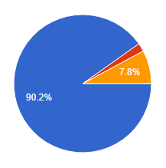
Operational Feasibility
2%
Teachers who want all of their lectures to be available on a single platform.
Teachers who want this system to be installed in their institutes.
Yes
No
Maybe

Slide 16
Economical Feasibility
DBM is providing some enhanced features which saves data cost and usage.
Installing DBM in any institute is much more easy and requires less cost.
So it is economically feasible.

Slide 17
AGENDA
01
Introduction
02
Comparison
03
Feasibility Study
Technical Feasibility
Operational Feasibility
Economical Feasibility
04
Problem Statement
05
Proposed System
06
Requirements
07
Project Modules
08
Annual Plan
09
Process Methodology
10
Business Plan
11
References

Slide 18
PROBLEM STATEMENT
“To make a storage and bandwidth efficient system with a lecture player and learning management system for the students and the educational institutes.”

Slide 19
AGENDA
01
Introduction
02
Comparison
03
Feasibility Study
04
Problem Statement
05
Proposed System
06
Requirements
07
Project Modules
08
Annual Plan
09
Process Methodology
10
Business Plan
11
References

Slide 20


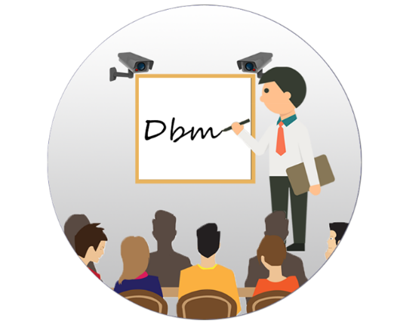
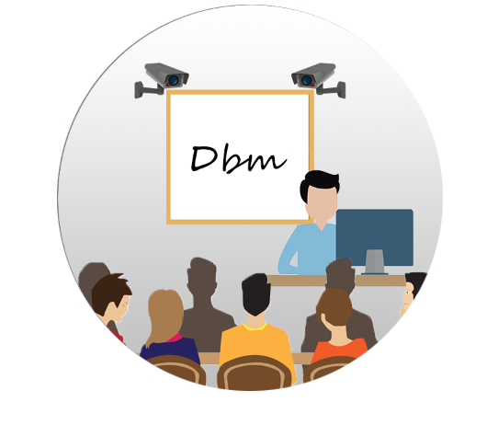


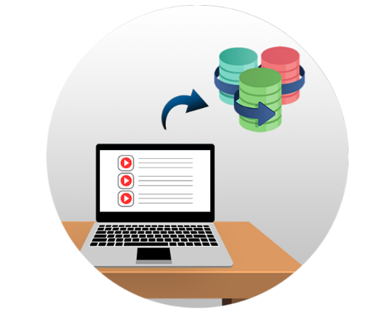

Open the controller app and enter details of the lecture.
At the end of lecture, press ‘Start’ button on controller application.
At the end of lecture, press ‘END’ button on controller application.
General Flow
Play the lecture online or offline
Open web application and browse through list of lectures
Lecture saved and uploaded on web server.

Slide 21
SYSTEM FEATURES
Customized Player
Notes Management
Course Management
DBM
Assignment management
Announcement Management
Lecture Recording

Slide 22
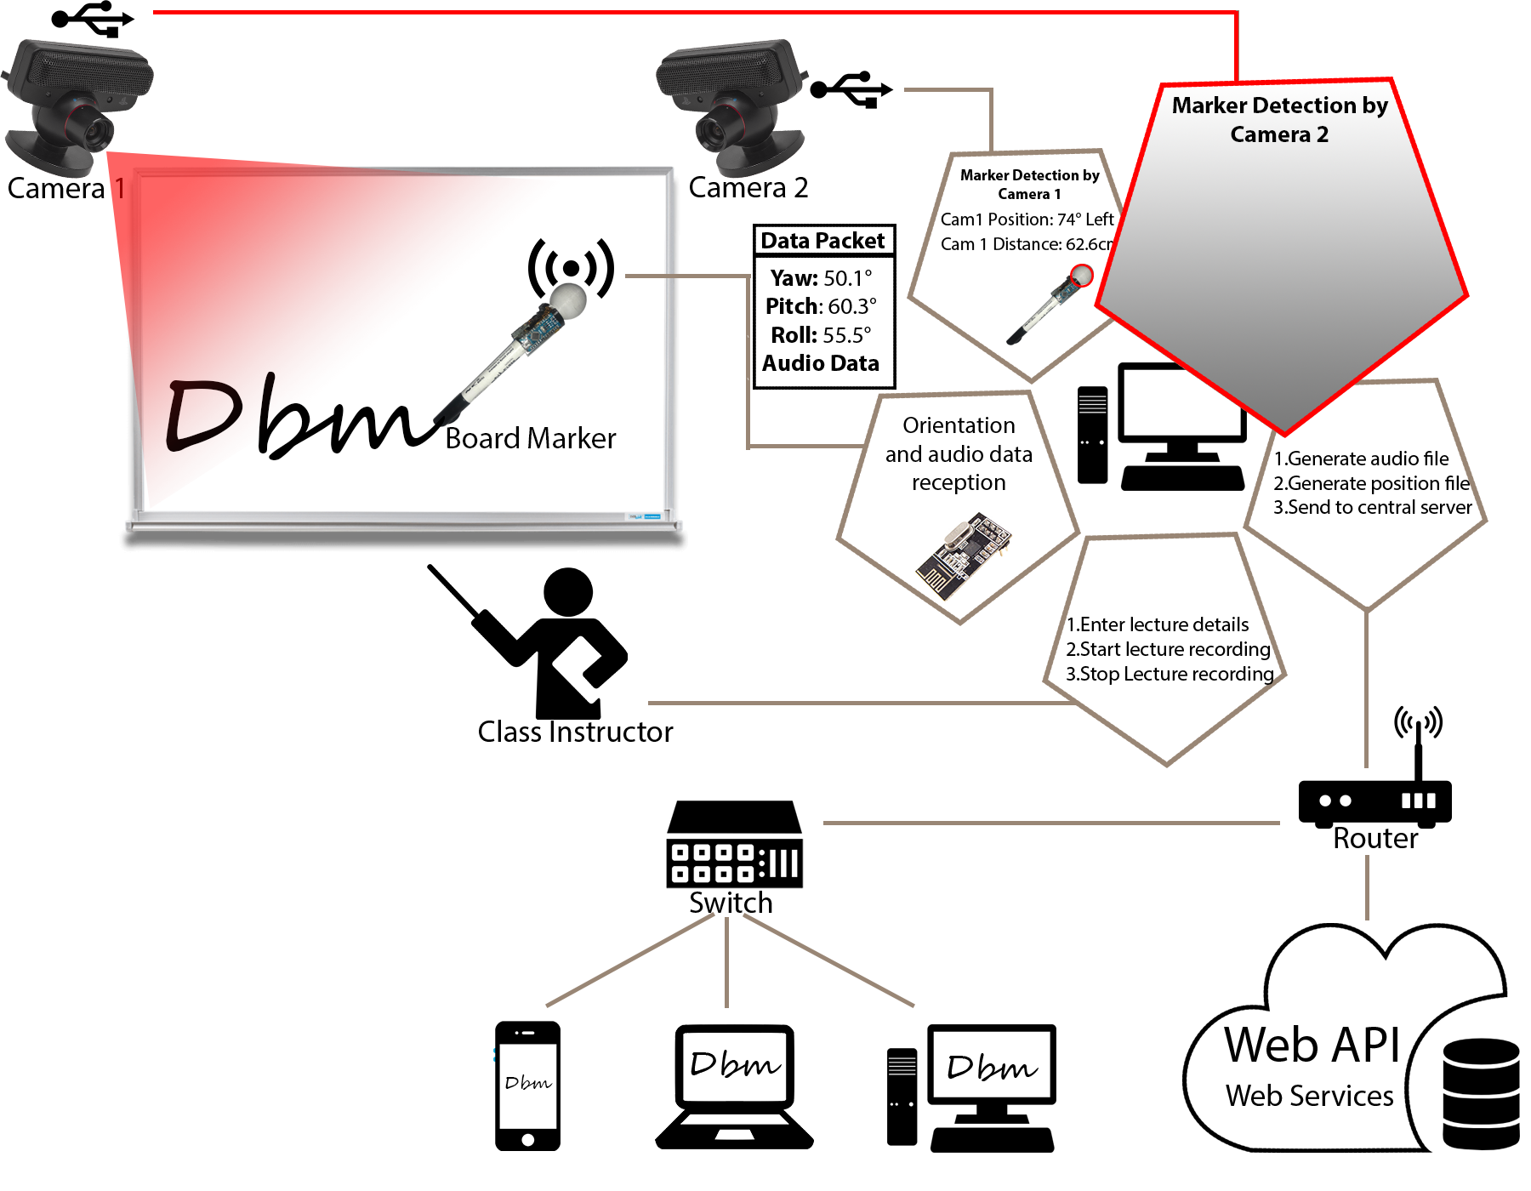
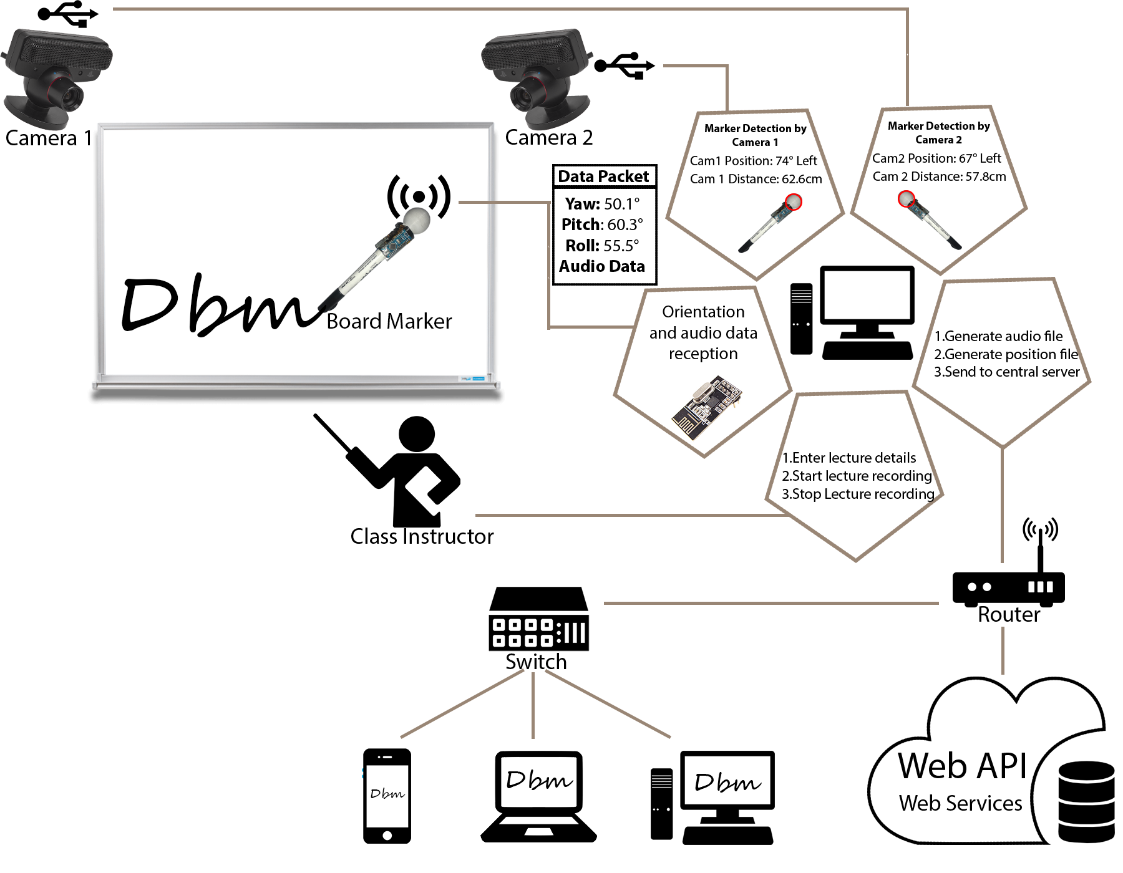
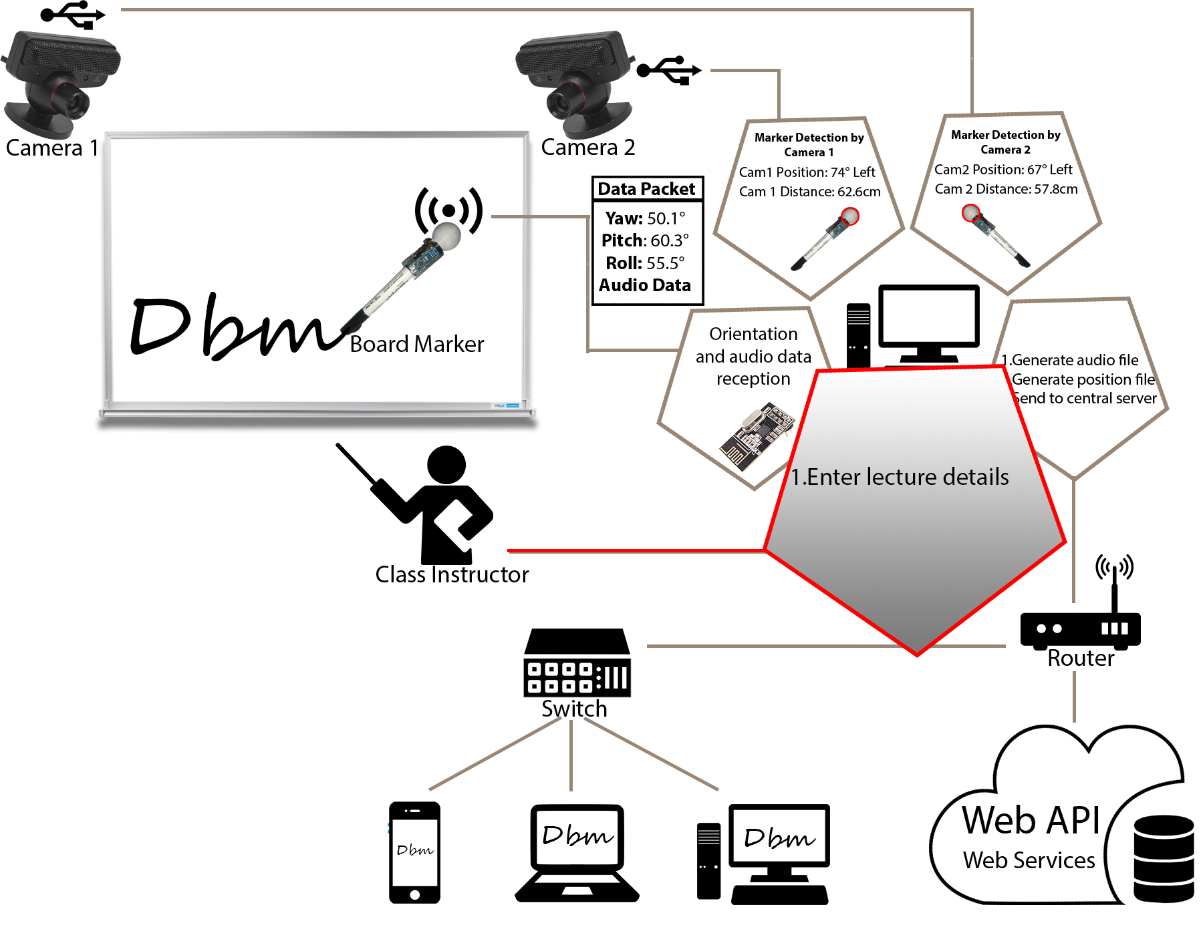
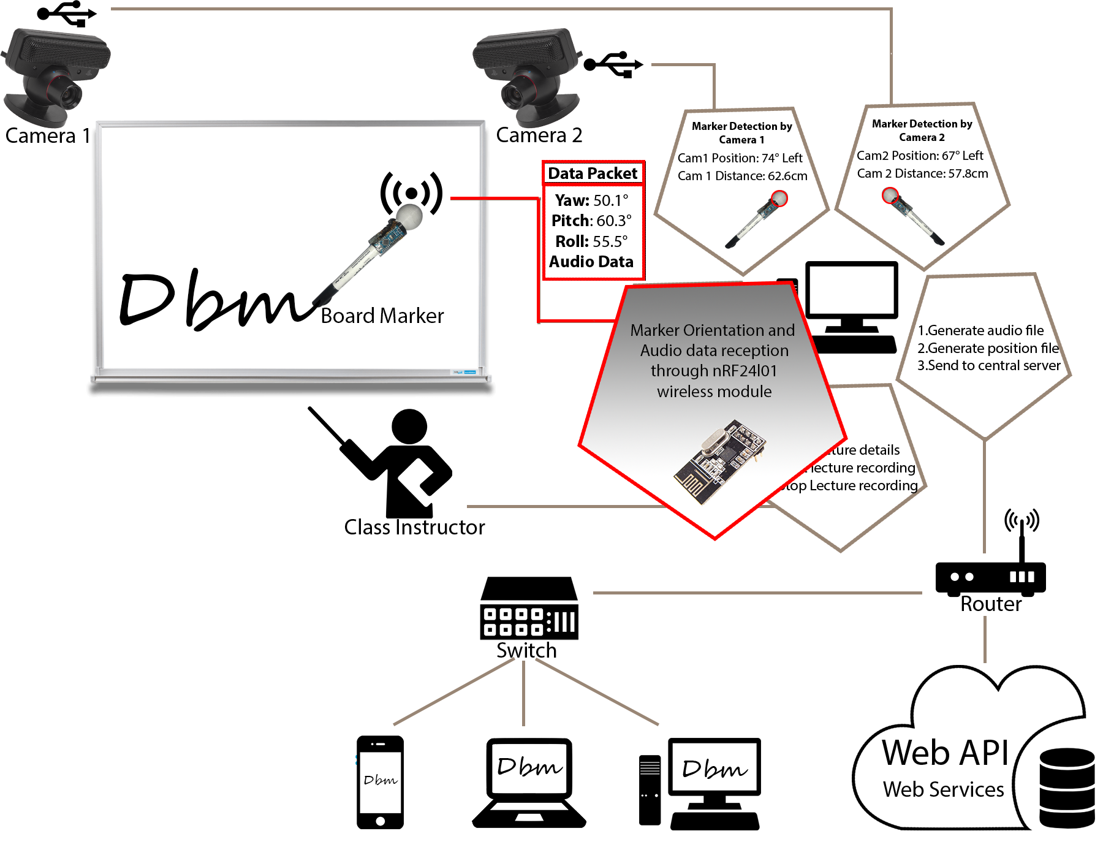
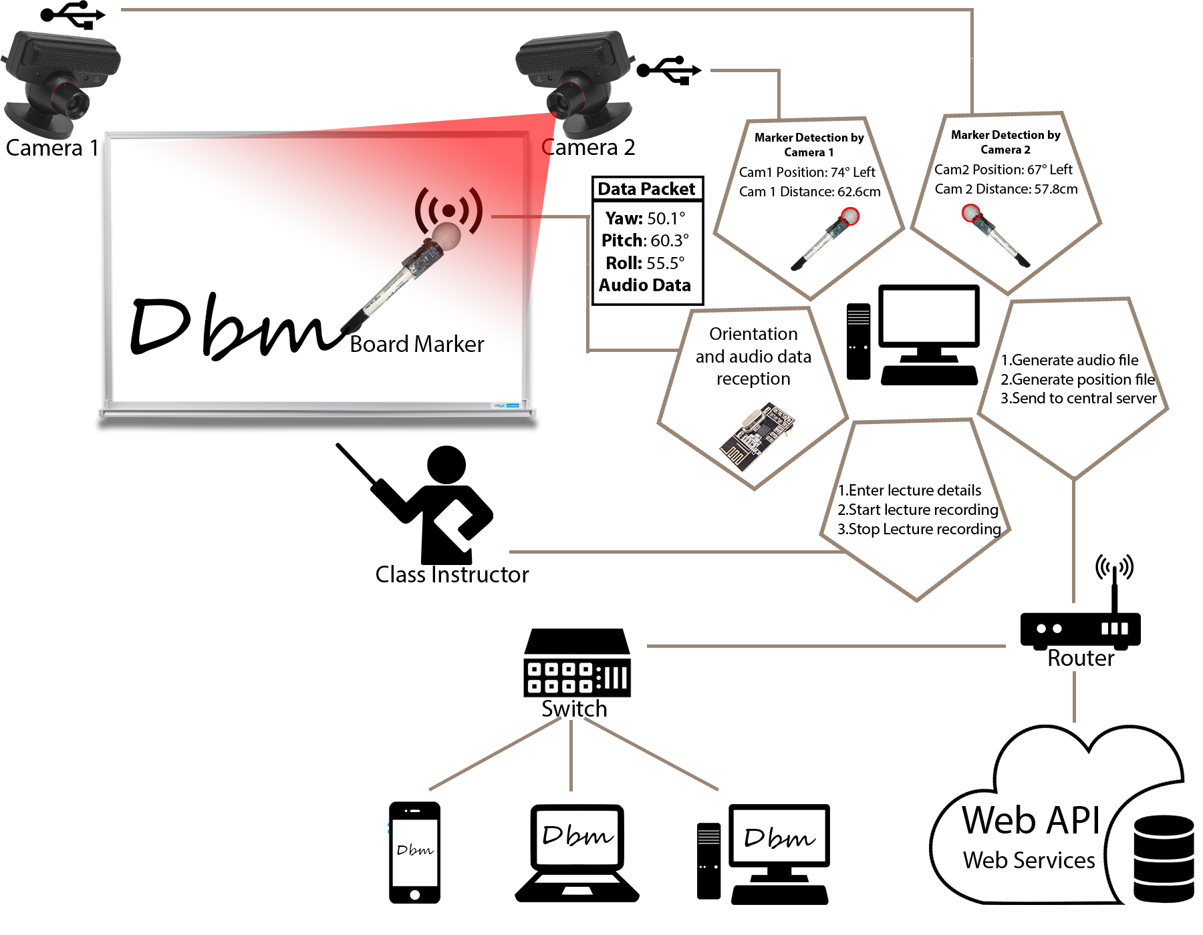
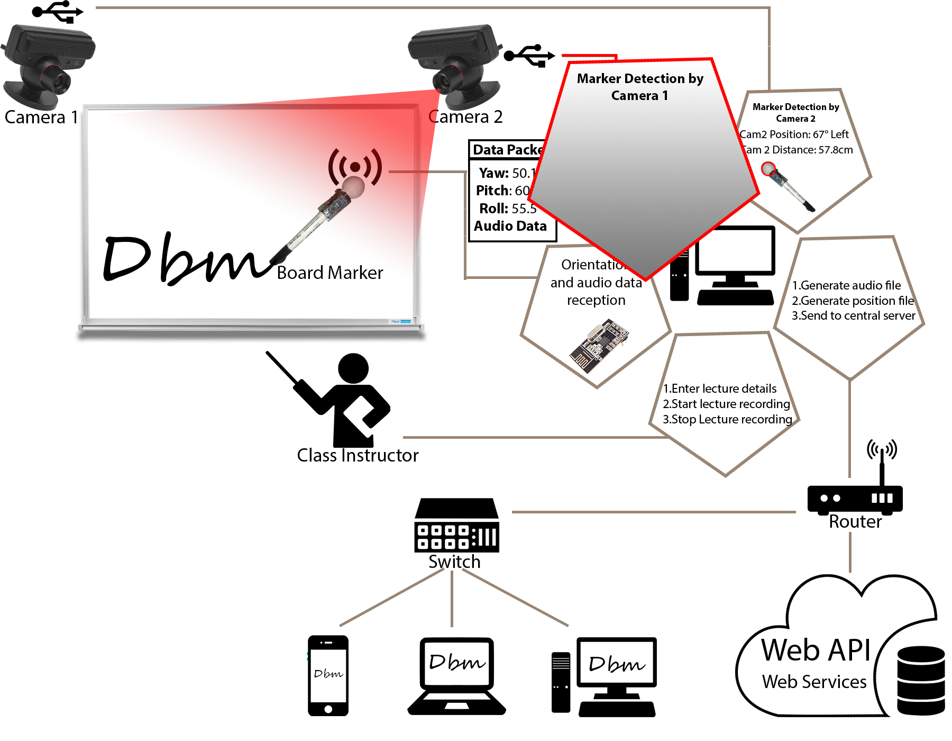

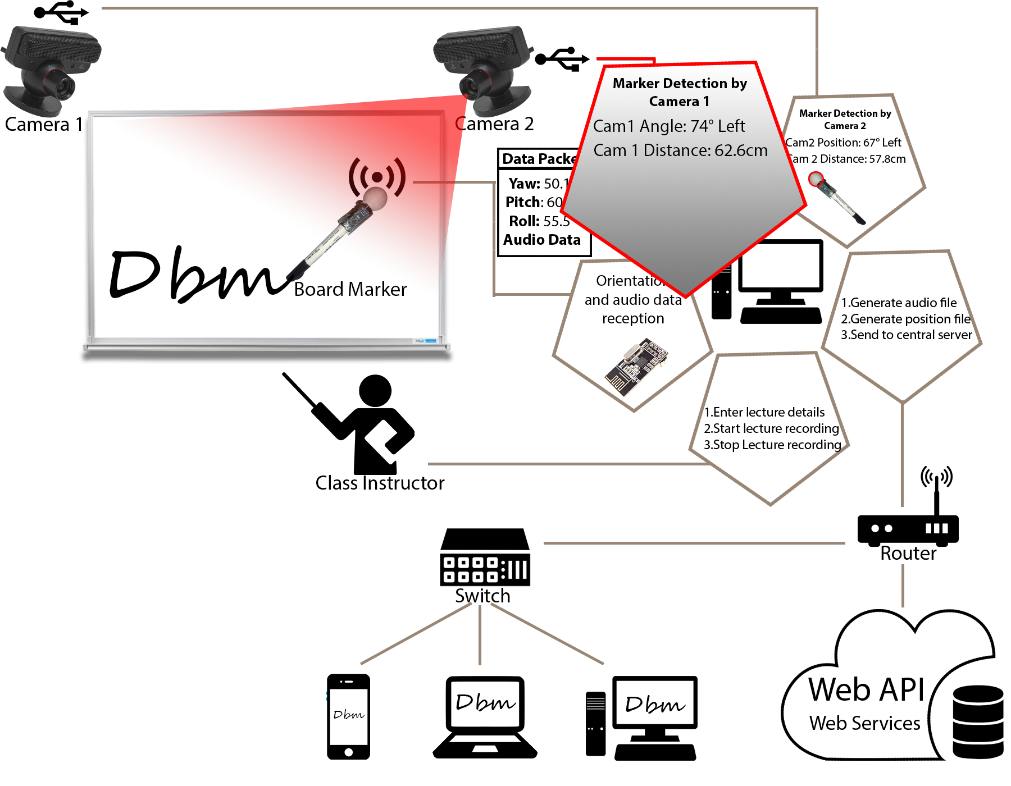

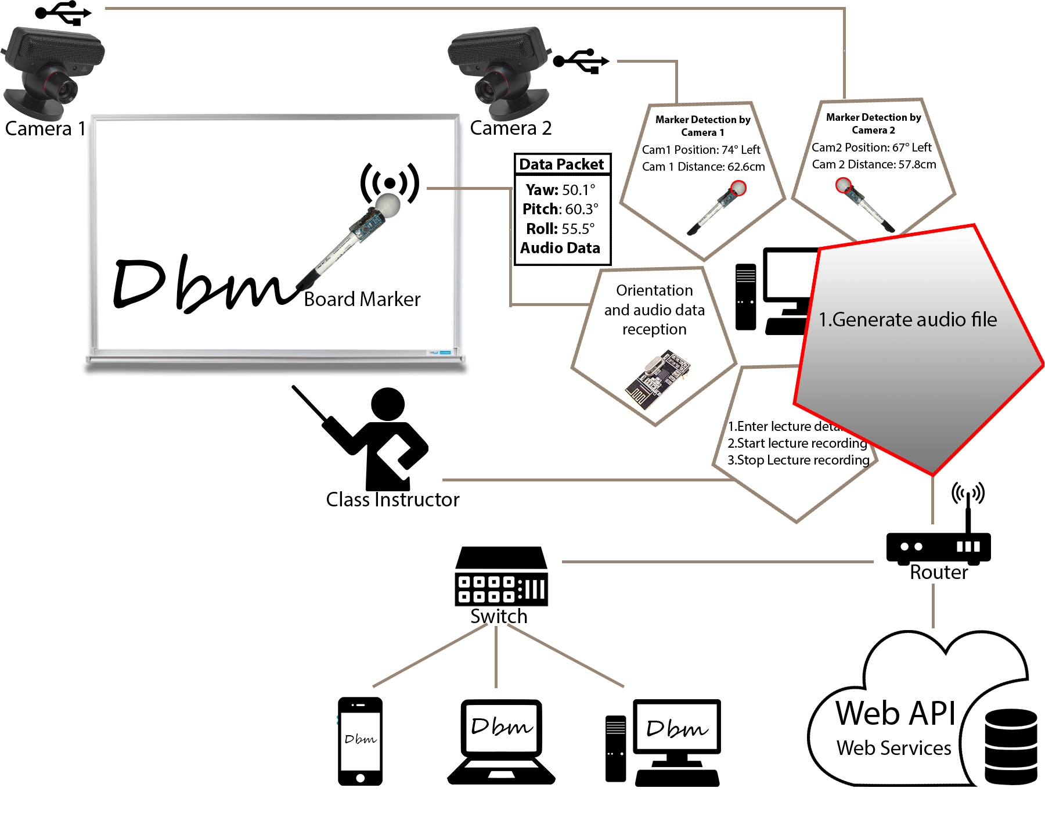
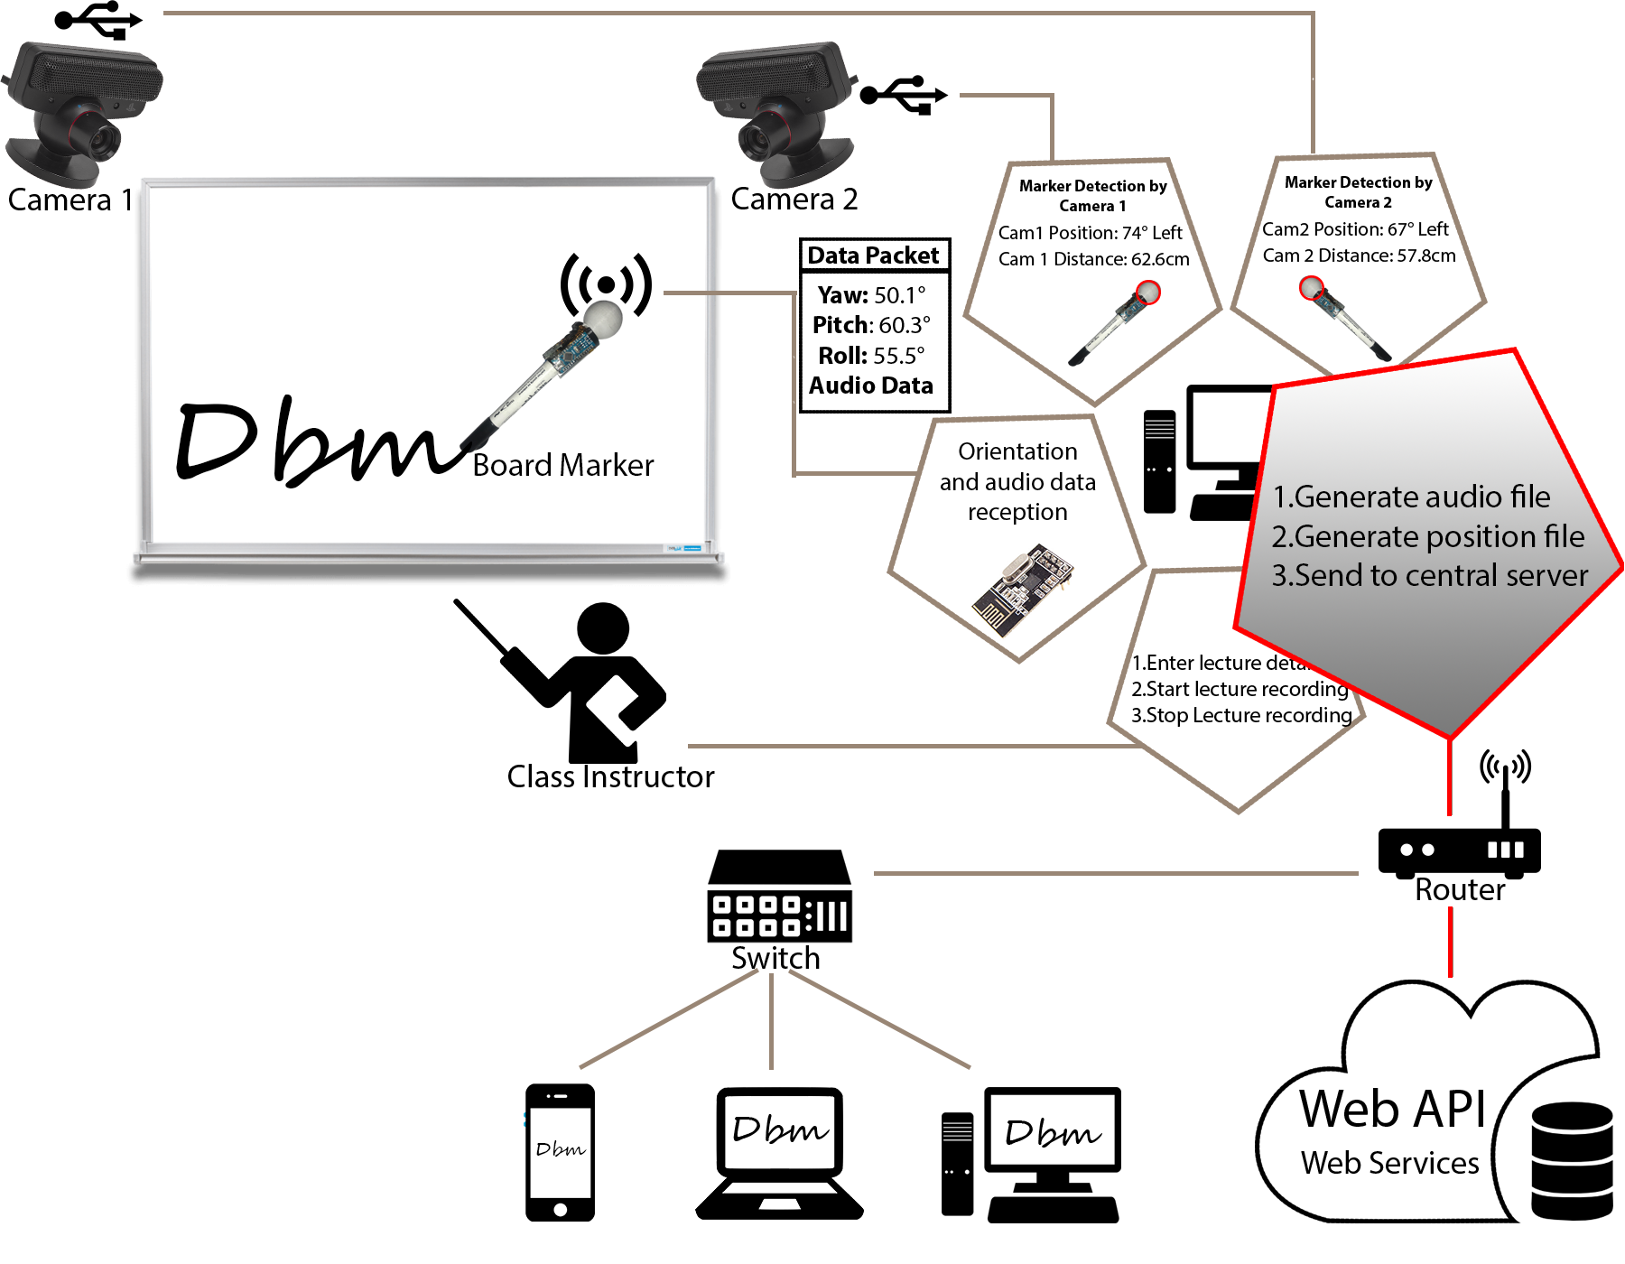
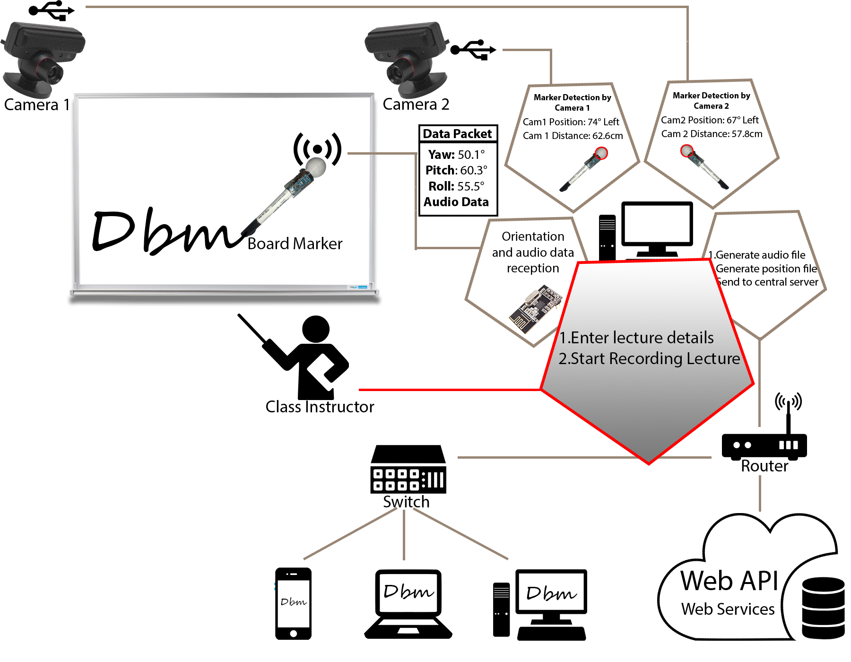
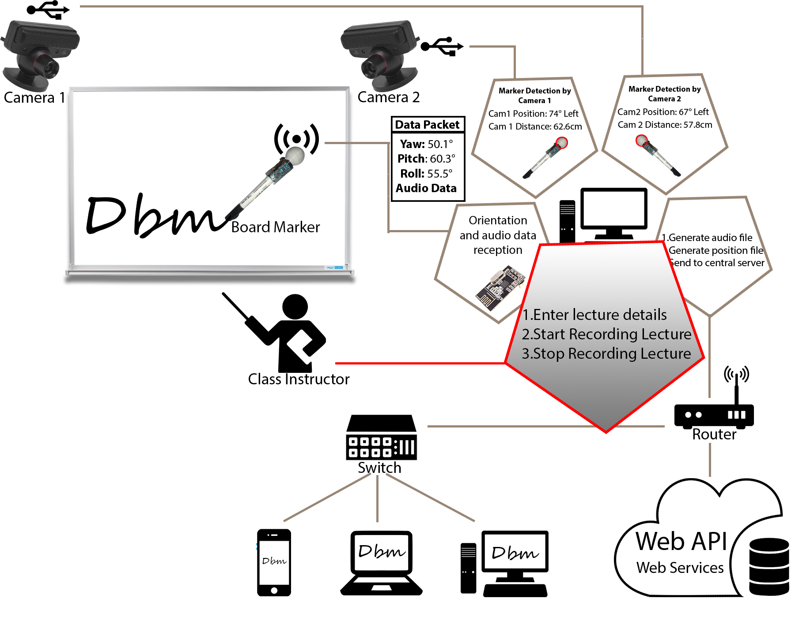
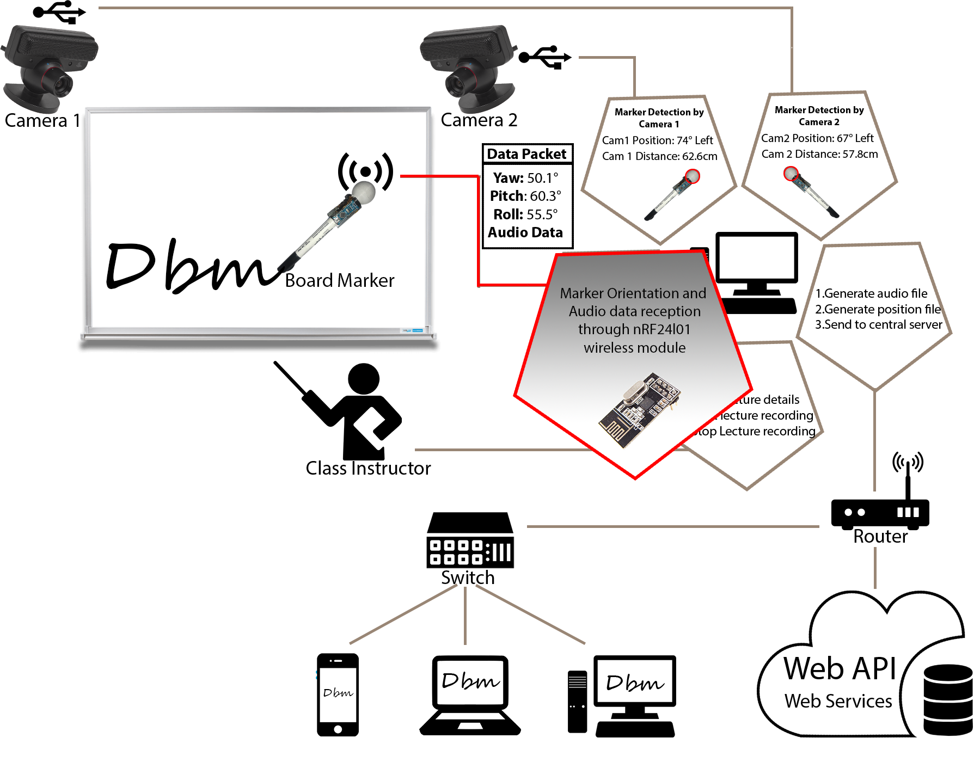
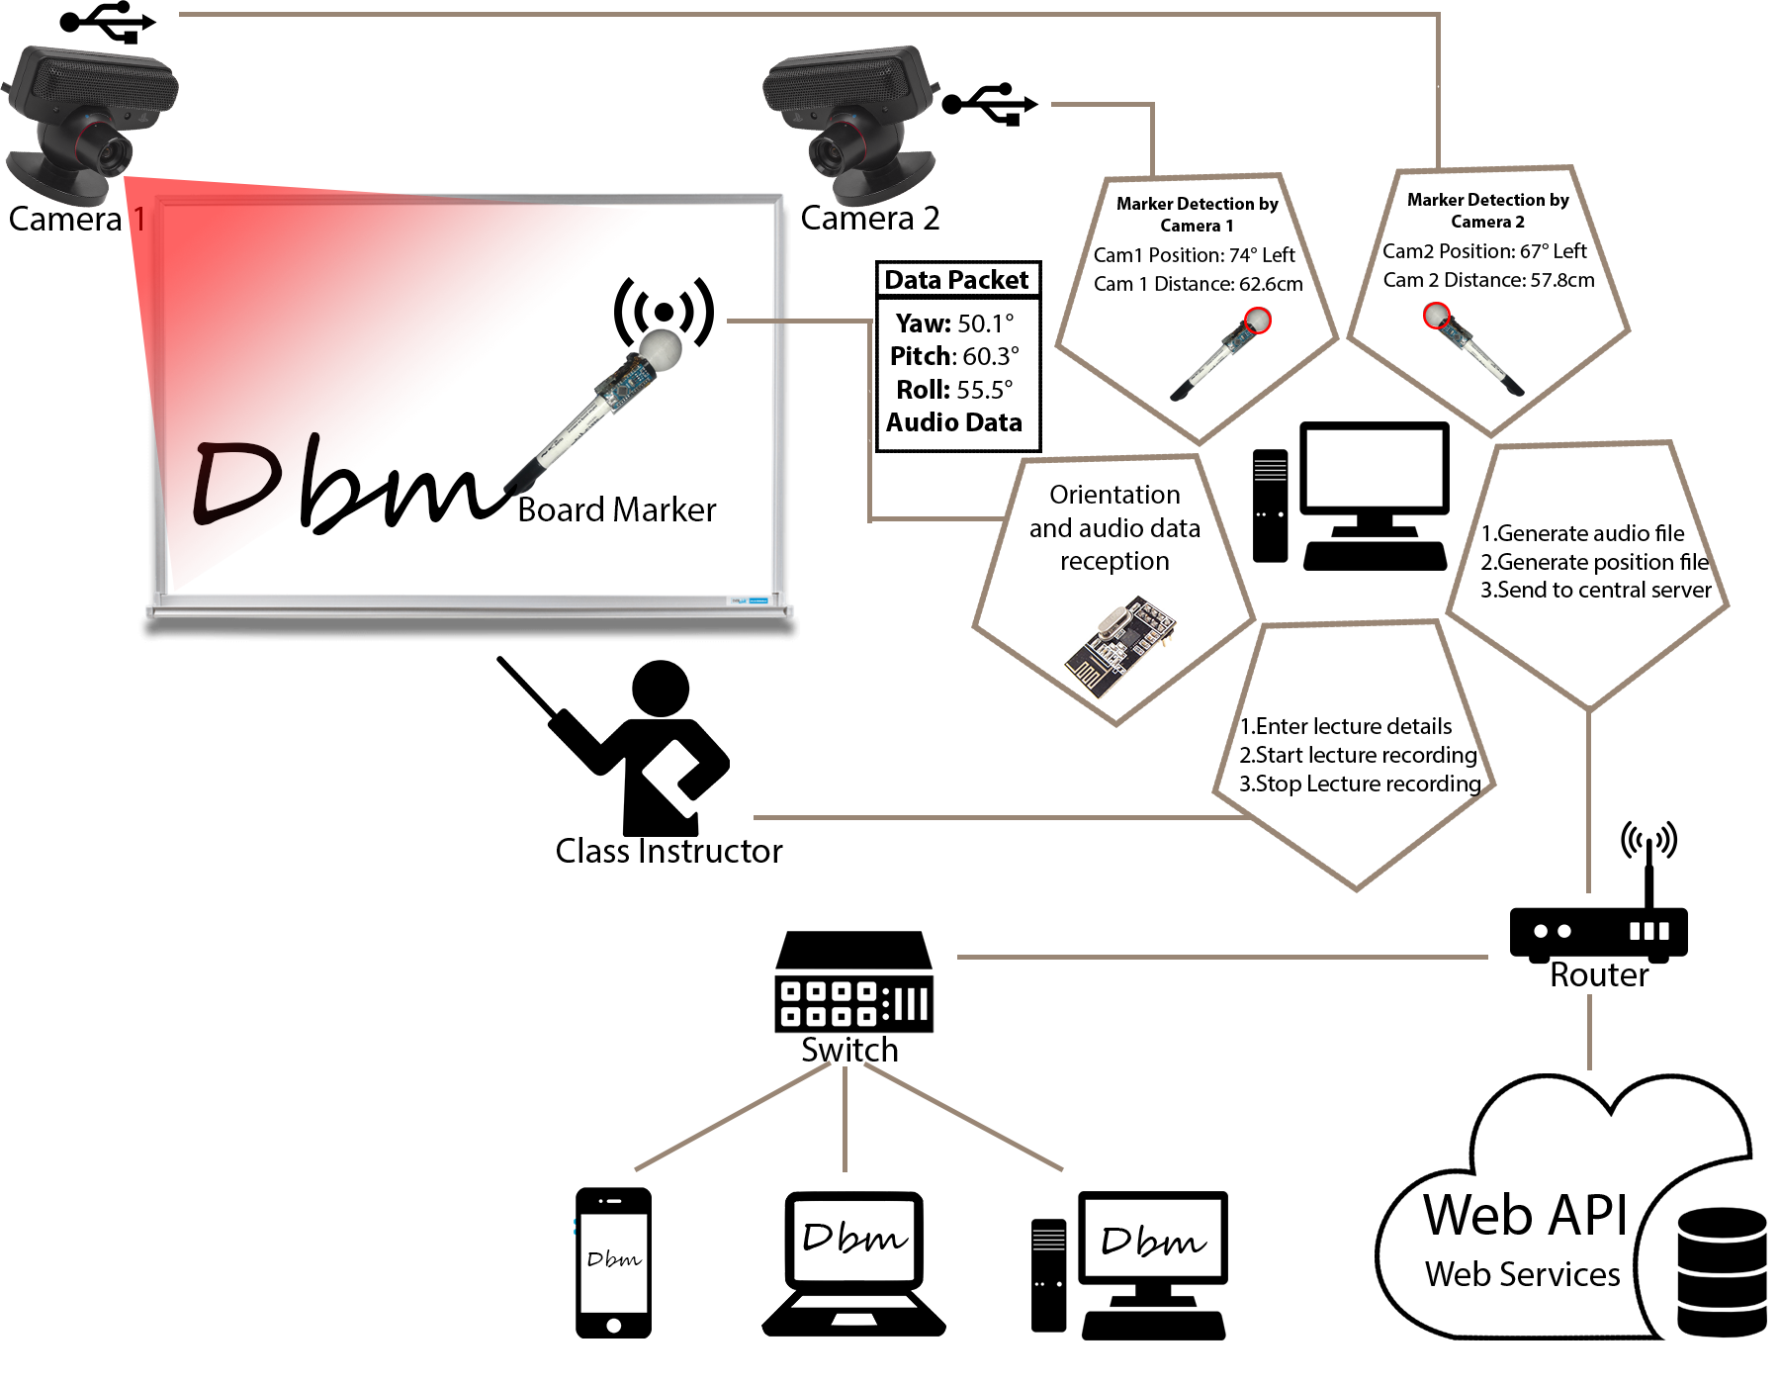

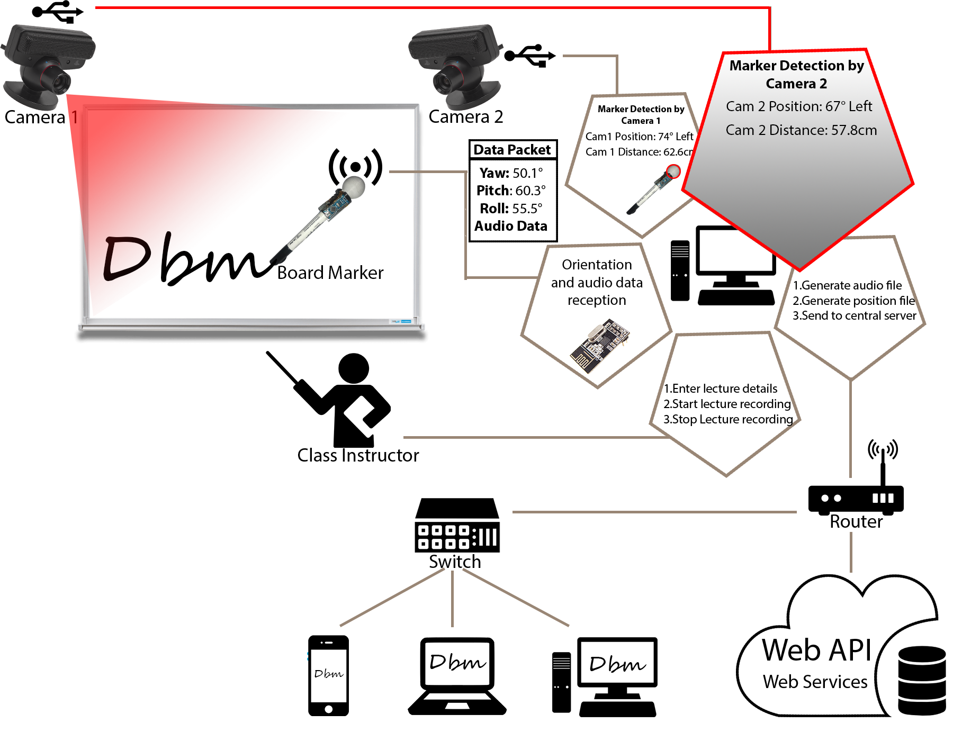
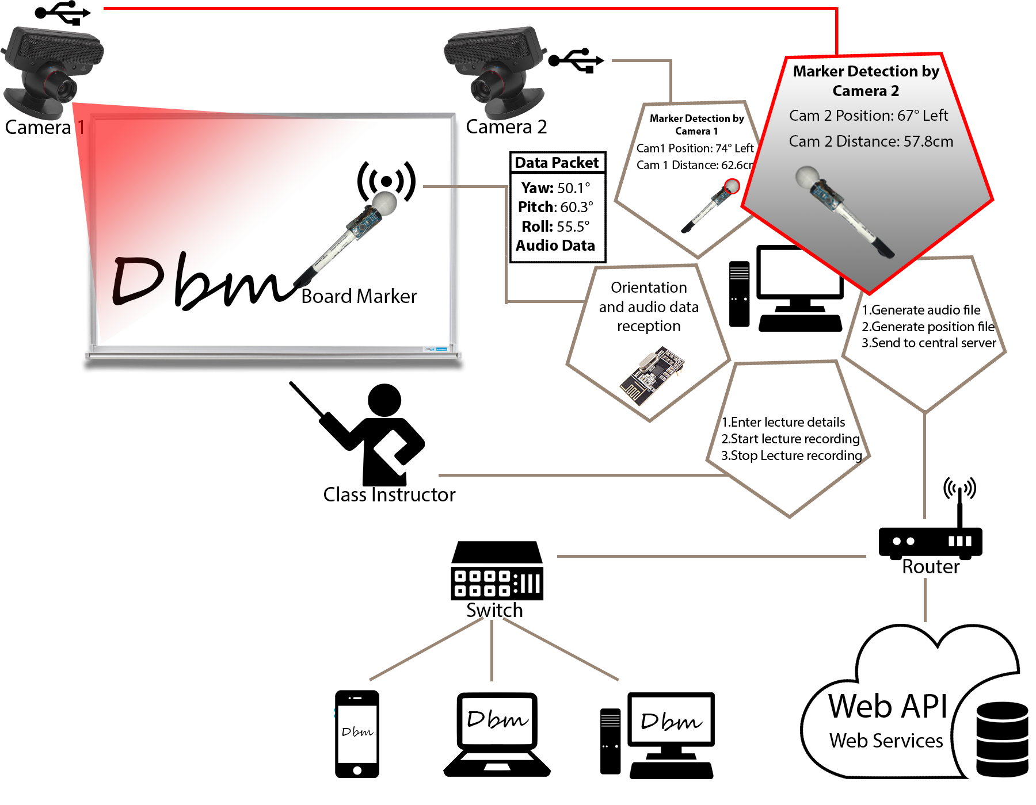

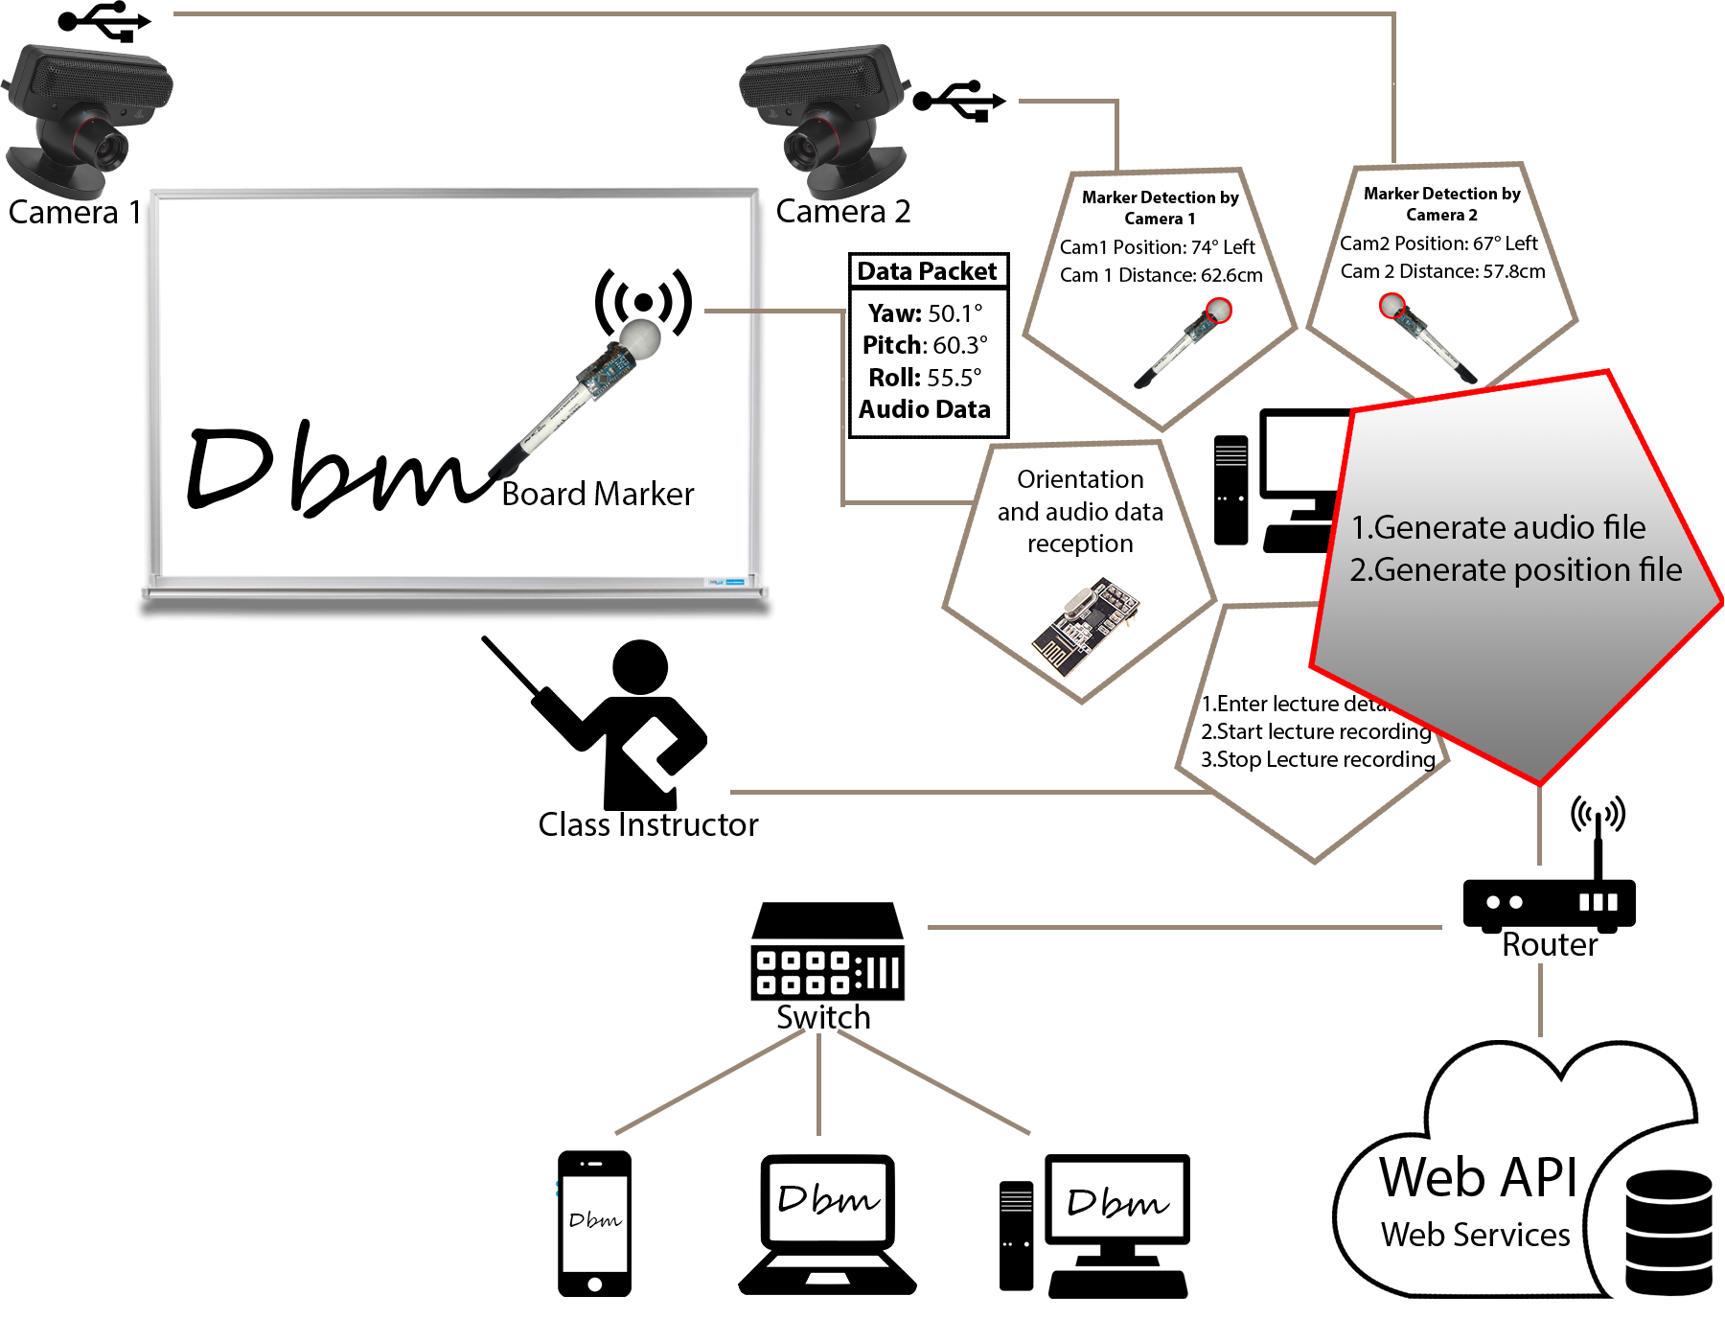
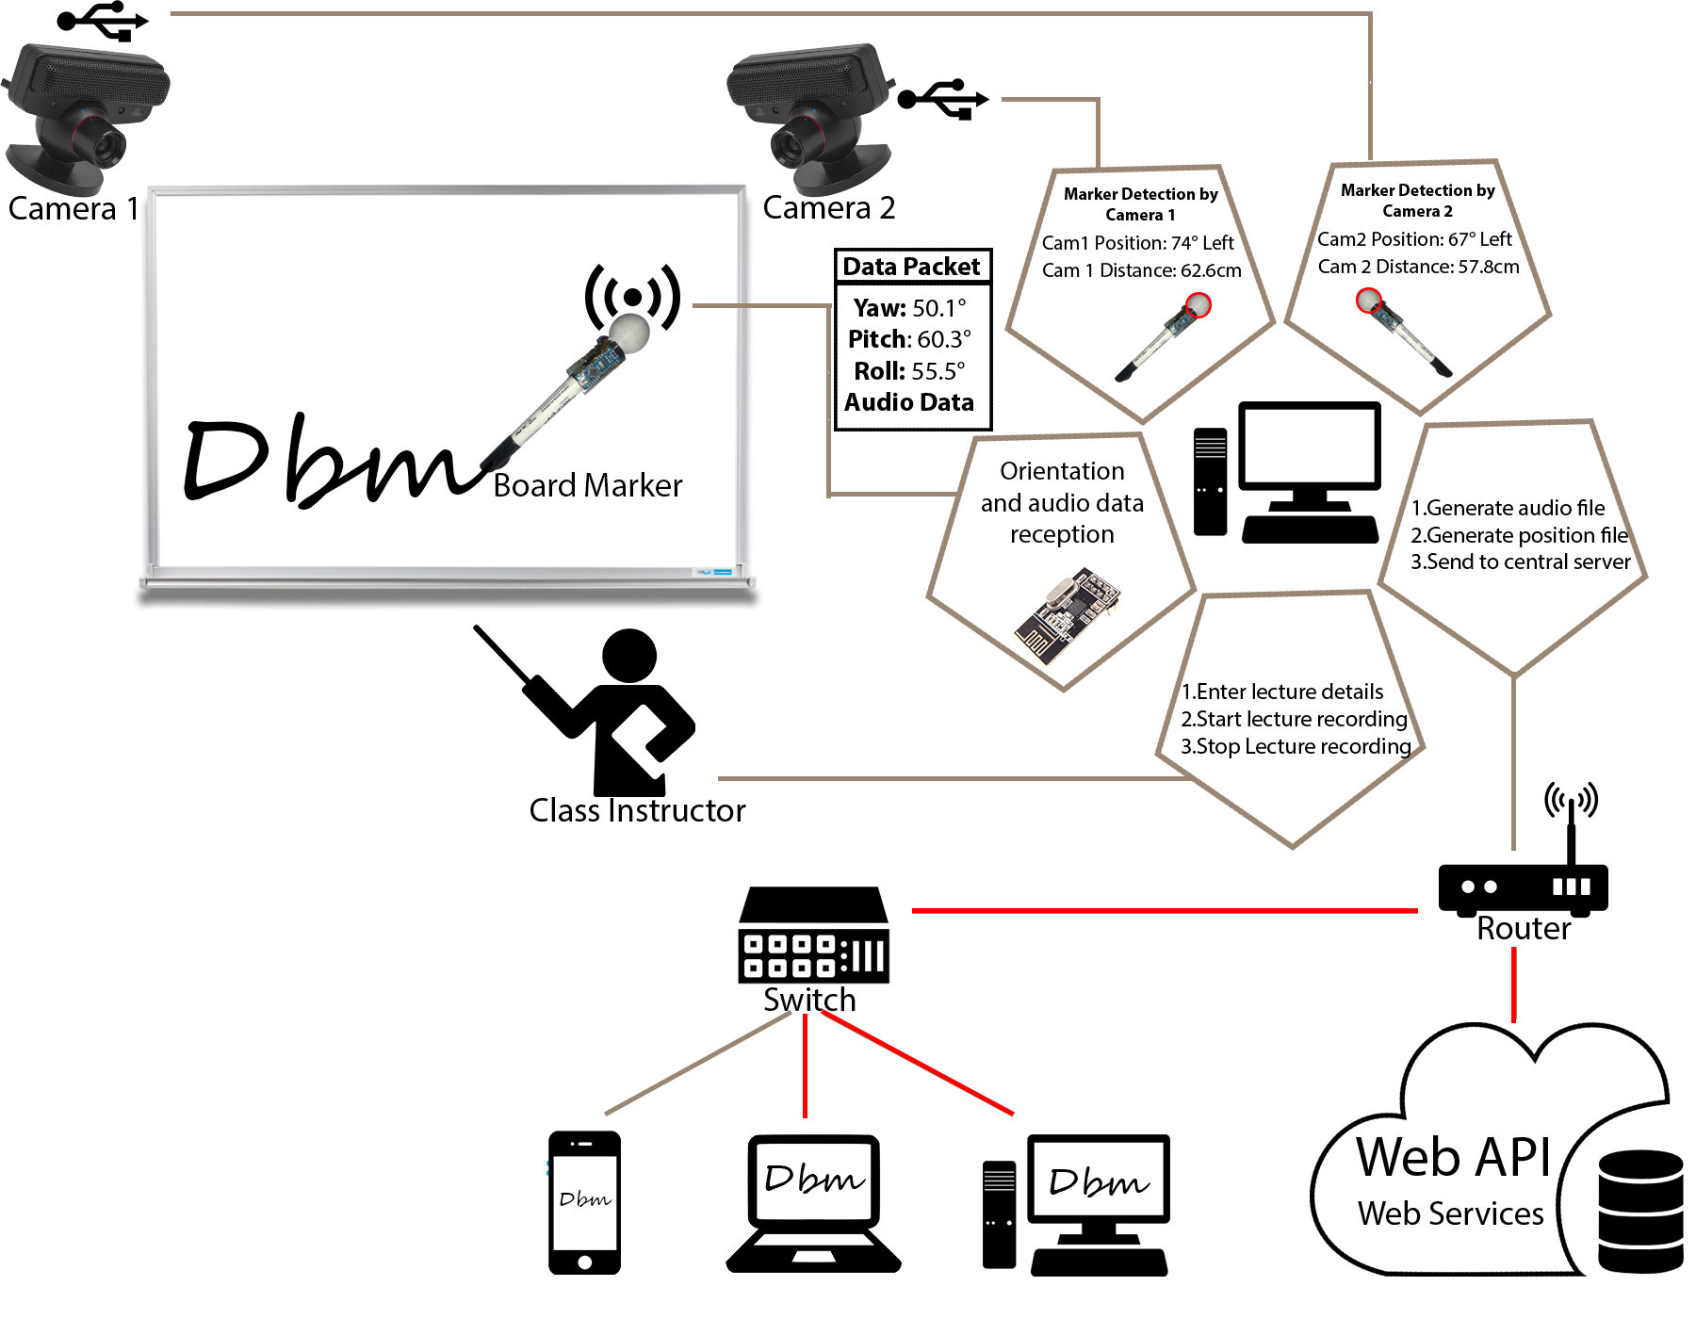
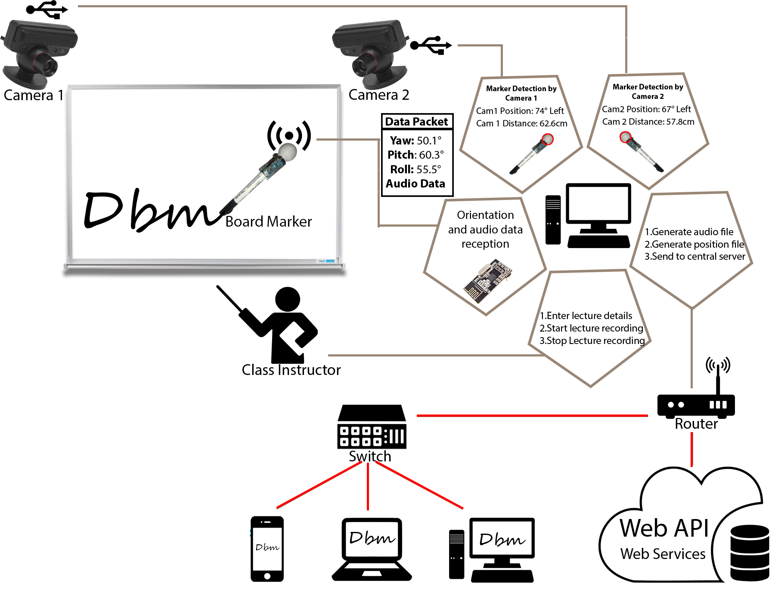


Architecture Diagram

Slide 23
AGENDA
01
Introduction
02
Comparison
03
Feasibility Study
04
Problem Statement
05
Proposed System
06
Requirements
07
Project Modules
08
Annual Plan
09
Process Methodology
10
Business Plan
11
References

Slide 24
HARDWARE REQUIREMENTS
RAM 2GB
Hard disk space 2GB
Processor 2GHz or higher
minimum Resolution 1280x720
Keyboard
Mouse

Slide 25
SOFTWARE REQUIREMENTS
Arduino 1.8.9
Processing 3.5.3
Cl-eye driver
IIS
Emgu 4.1
Colormine NuGet package
Sql Server
.NET framework for offline player

Slide 26
AGENDA
01
Introduction
02
Comparison
03
Feasibility Study
04
Problem Statement
05
Proposed System
06
Requirements
07
Project Modules
08
Annual Plan
09
Process Methodology
10
Business Plan
11
References

Slide 27
PROJECT MODULES
Board Marker and cameras synchronization
Controller Application
Voice transceiver
Offline Player
LMS

Slide 28
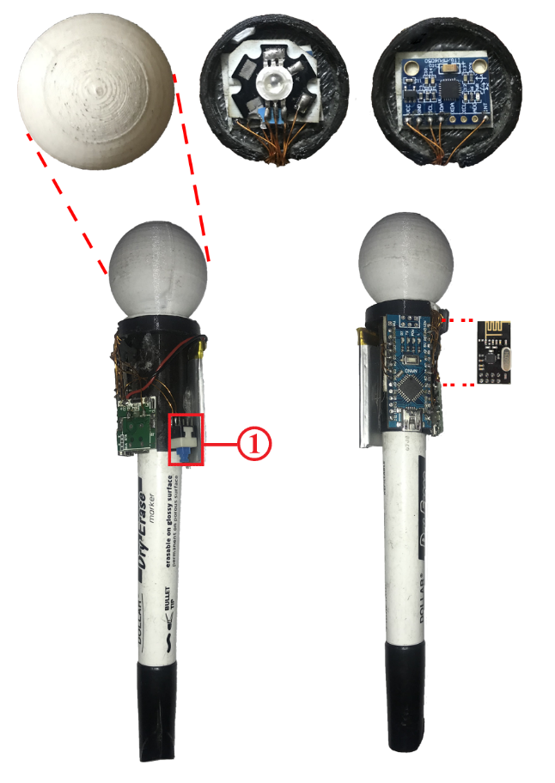
BOARD MARKER
Tact Tactile Switch
USB DC-DC Boost Converter
Glowing Ball
Arduino Nano
Lipo Battery
dc-le14112 RGB Led
MPU-6050
nRF24L01
7
6
3
8
5
2
4

Slide 29
CONTROLLER APPLICATION
Marker position extraction.
Marker orientation extraction.
Audio data reception.
Lecture recording control.
JSON file generation.
Connection with web application.

Slide 30
VOICE TRANSRECEIVER
Transfer live voice data to controller application.
Transfer of data with minimum latency.
Stand alone module, runs on battery.

Slide 31
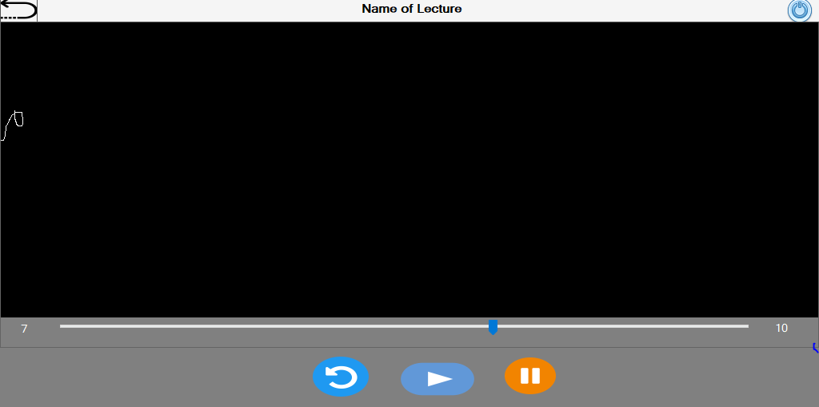
OFFLINE PLAYER
DBM
Player Screen
Elapsed Time
Total Time
Track Bar
Play Button
Start Over Button
Pause Button

Slide 32

Web Application
Admin:
Admin can approve teachers and student registration requests.
Admin can add new courses.
Admin can assign courses to teacher.
Teacher:
Teacher can register and then login to his/her account.
Teacher can approve enrolment request of students.
Teacher can upload course notes.
Teacher can upload assignments.
Teacher can download all students submitted assignments.

Slide 33
Web Application
3. Student:
Student can register and then login to his/her account.
Student can see lectures.
Student can see and download notes.
Student can see and download assignments.
Student can submit assignments.
Student can enroll in course.

Slide 34
AGENDA
01
Introduction
02
Comparison
03
Feasibility Study
04
Problem Statement
05
Proposed System
06
Requirements
07
Project Modules
08
Annual Plan
09
Process Methodology
10
Business Plan
11
References

Slide 35
Annual Plan
Sr No. | Task Name | Duration | Start Date dd/mm/yy | Finish Date dd/mm/yy | Resource Name
1 | 3d design of marker | 2 Days | Thu 04/07/19 | Fri 05/07/19 | Hamza
2 | Accelerometer data analysis | 2 Days | Sat 06/07/19 | Mon 08/07/19 | Hamza
3 | nRF wireless module data exploration | 2 Days | Tue 09/07/19 | Wed 10/07/19 | Hamza
4 | Development of Wireless Module | 2 Days | Thu 11/07/19 | Fri 12/07/19 | Hamza
5 | Integration of orientation data with controller app | 7 Days | Sat 13/07/19 | Sun 21/07/19 | Hamza
6 | Integration of video stream with desktop app | 2 Days | Mon 22/07/19 | Tue 23/07/19 | Hamza
7 | Implementation of RGB Led | 2 Days | Thu 24/07/19 | Sat 26/07/19 | Hamza

Slide 36
Sr No. | Task Name | Duration | Start Date dd/mm/yy | Finish Date dd/mm/yy | Resource Name
8 | Development of stereo vision cameras | 14 Days | Wed 24/07/19 | Mon 12/08/19 | Hamza
9 | Synchronization of camera video and orientation data | 7 Days | Tue 13/08/19 | Wed 21/08/19 | Hamza
10 | Feasibility study of raspberry Pi | 13 Days | Thu 22/08/19 | Sun 08/09/19 | Hamza
11 | Contour Detection | 3 Days | Mon 09/09/19 | Wed 11/09/19 | Hamza
12 | Boundary and position extraction of contour | 7 Days | Thu 12/09/19 | Fri 20/09/19 | Hamza
13 | Voice data transmission through nRF module | 14 Days | Sat 21/09/19 | Wed 09/10/19 | Hamza
14 | Voice data synchronization with application | 4 Days | Thu 10/10/19 | Tue 15/10/19 | Hamza

Slide 37
Sr No. | Task Name | Duration | Start Date dd/mm/yy | Finish Date dd/mm/yy | Resource Name
15 | Video player desktop app | 3 Days | Thu 04/07/19 | Mon 08/07/19 | Komal, Ayesha, Haris
16 | Web app development | 67 Days | Mon 15/07/19 | Tue 15/10/19 | Komal, Ayesha, Haris
17 | Database design | 3 Days | Thu 18/07/19 | Wed 17/07/19 | Haris
18 | Frontend development | 12 Days | Sat 03/08/19 | Fri 02/08/19 | Komal
19 | User account management | 2 Days | Tue 06/08/19 | Mon 05/08/19 | Komal, Ayesha, Haris
20 | Integration of player | 24 Days | Tue 06/08/19 | Fri 06/09/19 | Ayesha, Haris
21 | Live streaming | 24 Days | Tue 10/09/19 | Fri 06/09/19 | All
22 | LMS | 18 Days | Fri 06/09/19 | Thu 03/10/19 | All
23 | Active learning | 45 Days | Thu 07/11/19 | Thu 07/11/19 | All
24 | Google Browsing | 23 Days | Sun 08/12/19 | Sat 07/12/19 | All

Slide 38
AGENDA
01
Introduction
02
Comparison
03
Feasibility Study
04
Problem Statement
05
Proposed System
06
Requirements
07
Project Modules
08
Annual Plan
09
Process Methodology
10
Business Plan
11
References

Slide 39
Methodology
Daily Scrum
Sprint Planning for LMS
Sprint Backlog for LMS
DBM Backlog
Homepage
Sprint Execution
Frontend
Login Page
LMS
Dashboard
Theme
Marker
Player
Forms
Layout
Scrum Master
Product Owner
Team Members
Inspect
Potentially shippable product increment
Inspect
Adapt
Adapt
Sprint Review
Sprint Retrospective

Slide 40
AGENDA
01
Introduction
02
Comparison
03
Feasibility Study
04
Problem Statement
05
Proposed System
06
Requirements
07
Project Modules
08
Annual Plan
09
Process Methodology
10
Business Plan
11
References

Slide 41





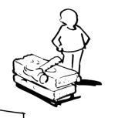



Business Model Canvas Designed For
Digital Board Marker
Key Partners | Key Activities | Value Propositions |  | Customer Relationships | Customer Segments
 | Key Resources |  |  | Channels
Cost Structure |  |  | Revenue Streams
PCB, IoT modules Manufactures and Retailers
Development of IoT hardware
Development of LMS web application
B2C Market
-No need of expensive camcorders
-Less internet usage
-Faster upload speeds
-Faster download and play speeds
Students that need jotting down the lecture
Students that cannot remember each and every word said by teacher in the class
Students that face less storage issue while storing lectures
Students that face less internet data issue while downloading lectures
Students that want to access lectures their own class lectures online
-Official Website
-Blog/Facebook Page
-Social Network
-Telephone
-Customer Congress
Development of Offline player application
Perform product research and take surveys
Cloud Computing Internet Service Provider
Lecture Content as documents and animation files (Virtual)
B2B Market
-More Student concentration
-Less student effort
-Storage efficiency
-Sufficient Lecture data storage capacity
-Low internet bandwidth required
-Social media Adverts
-Online Shop Platforms
-Direct Sale to Education institutes
-Seminars and presentations held in Education institutes
Investors and Lobbyists
Marker hardware, Web server and controller computers (Physical)
LMS and Offline player (Virtual)
-Online Lecturers
-Artists that need to record their work
(Software)
LMS (Adverts, Rs 20, 000)
Controller App, Offline Player (Adverts)
Permanent employees and maintainers (-50% of the Revenue)
(Hardware)
Digital Board Marker hardware (Rs 8, 500)
Desktop PC (Rs 2000)
Central Server (Rs 5, 000)
17% of cost of Digital Board Marker Hardware that is Rs 1500 that is 150, 000 per 100 hardware modules sold
LMS, Controller App, Offline Player adverts that is Rs 100, 000 per month
Rs 20, 000 revenue on each LMS software sold

Slide 42
Learning Curve
10
9
8
7
6
Daily Time Spent (hr)
5
4
Azure/Django Deployment
Object Models and Design
3
System Architecture
3ds Max Design
Offline Player App
Hardware Study
Research Papers
Hardware Study
Feasibility Study
2
Image Filters
Methodology
CV Course
.Net Core
Postman
Fritzing
Angular 8
Latex
Processing
1
SRS
June
July
August
September

Slide 43
AGENDA
01
Introduction
02
Comparison
03
Feasibility Study
04
Problem Statement
05
Proposed System
06
Requirements
07
Project Modules
08
Annual Plan
09
Process Methodology
10
Business Plan
11
References

Slide 44
References
Automated Lecture Recording System: https://www.csie.ntu.edu.tw/~fuh/personal/AutomatedLectureRecordingSystem.pdf
Multi Level Optimization in Encoding to Balance Video Compression and Retention of 8K Resolution: https://www.sciencedirect.com/science/article/pii/S221302091630091X
Lecture Capture: Student Perceptions, Expectations, and Behaviours: http://www2.inf.uos.de/papers_pdf/2010_02.pdf

Slide 45
References
Using Video to Record Summary Lectures to Aid Students’ Revision : http://www.ijklo.org/Volume3/IJKLOv3p185-196Whatley367.pdf
iRECLASS – AN AUTOMATIC SYSTEM FOR RECORDING CLASSES : https://arxiv.org/pdf/1501.00149
Implementation of a Lecture Capture Recording System in a Counselor Education Clinical Training Facility by Ann M. Miller & Robert Gibson: https://www.counseling.org/resources/library/VISTAS/2012_Vol_1_67-104/2_2012-ACA-PDFs/Article_91.pdf

Slide 46
References
4K Lecture Tracking System: Movement Recognition and Lecturer Tracking: https://track4k.co.za/downloads/Final%20Papers/4K%20Lecture%20Tracking%20System%20-%20Movement%20Recognition%20and%20Lecturer%20Tracking.pdf
Note This: How to Improve Student Note Taking IDEA Paper #73 • September 2018 : https://www.ideaedu.org/Portals/0/Uploads/Documents/IDEA%20Papers/IDEA%20Papers/IDEA_Paper_73.pdf

Slide 47
References
Taking Notes Together: Augmenting Note Taking: https://www.academia.edu/18825200/Taking_notes_together_Augmenting_note_taking
Video Compression Algorithm Based on Frame Difference Approaches: https://www.academia.edu/37731422/Video_Compression_Algorithm_Based_on_Frame_Difference_Approaches

Slide 48

Thank You!

Slide 49

Any Question?

